Slide 1

Texas Housing Market Analysis
Data Analytics & Visualization Project #1
Ali Karimi, Simon Castellanos, Jucary Estrada, Francis Escamilla
June 2021

Slide 2
Description & Scope
The goal of the project is to perform an analysis of the housing market in Texas and try to evaluate factors that may be potentially influencing the current trend.
Gather real state inventory data and pricing data for real state, Oil, lumber, copper, etc. To analyze supply demand influences, job market and construction costs. Use the data to evaluate the trends for each, compare it to the housing price trends and determine if there are significant correlations.

Slide 3
Questions (What is triggering rise in prices?)
What is the relation between population growth and number of house inventory?
What is the relation between cost of construction and increase in house prices?
Do oil prices influence demands for homes?

Slide 4
Data Resources
FRED Economic Research (https://fred.stlouisfed.org/). Used data from 1995 to 2021
Population Data by Metropolitan Area
All-Transactions House Price Index for Texas
West Texas Intermediate (WTI), Dollars per Barrel
Producer Price Index Copper Wire and Cable
Producer Price Index Iron and Steel
Producer Price Index Lumber
Zillow Housing Data (Housing Data - Zillow Research)
Median Home Values and number of house listing by Metropolitan Area
A-S

Slide 5
Data Exploration and Clean Up
Describe the exploration and cleanup process
Discuss insights you had while exploring the data that you didn't anticipate
Discuss any problems that arose after exploring the data, and how you resolved them
Present and discuss interesting figures developed during exploration, ideally with the help of Jupyter Notebook
A-S

Slide 6
Analysis Process
Discuss the steps you took to analyze the data and answer each question you asked in your proposal
Present and discuss interesting figures developed during analysis, ideally with the help of Jupyter Notebook
A-S

Slide 7
Visualizations and Observations

Slide 8
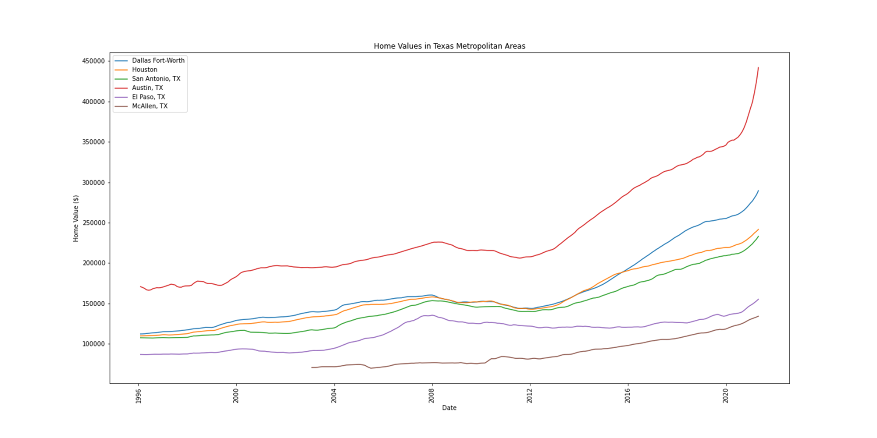
Home Values
Texas metropolitan areas are experiencing an increase in home values. Austin shows to have higher home values compared to other Texas cities. It also shows to have the most significant increase in prices, followed by Dallas. McAllen on the other hand has the lowest valued homes and although the price values are increasing, it seems to be at a steady pace relative to the rest of the state.

Slide 9
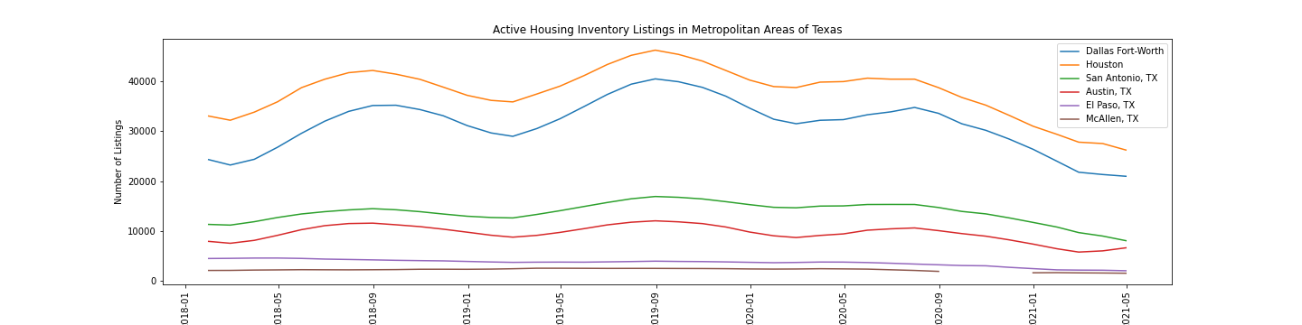
Listing Inventory
We can demonstrate starting in the middle of the year 2020 the inventory in housing decreased drastically compared to previous years.

Slide 10
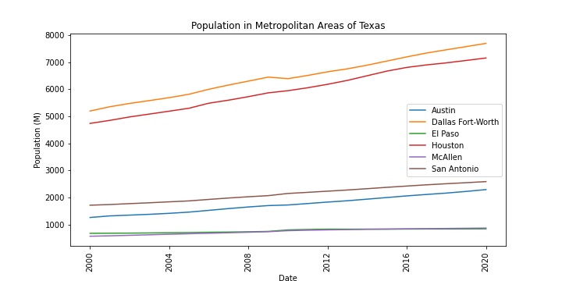
Population Growth

Slide 11
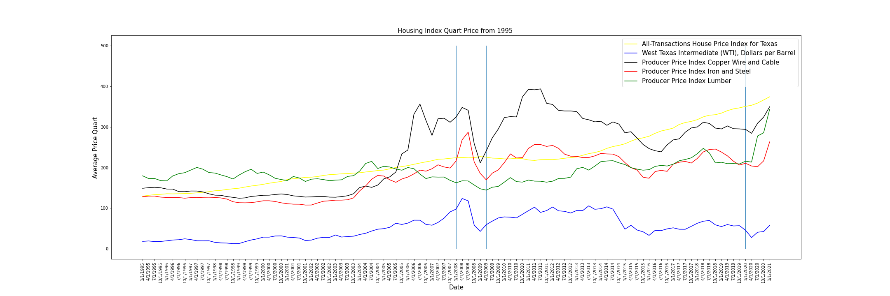
Housing Index vs. Commodities Index
The housing price changes is not immediate to changes in price fluctuation. In 2008 the housing crisis did not affect Texas. We can analyze from the graph the price index started increasing rapidly starting in 2014.

Slide 12
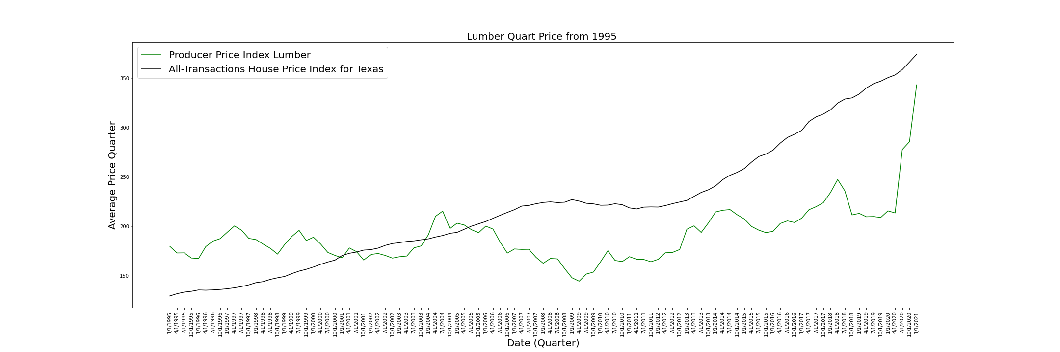
The demonstration shows a drastic change in Lumber prices after April 2020 increasing the price of construction. Predicting if the price of lumber continues to increase, we can expect the price of construction to continue to increase.
Lumber Price

Slide 13
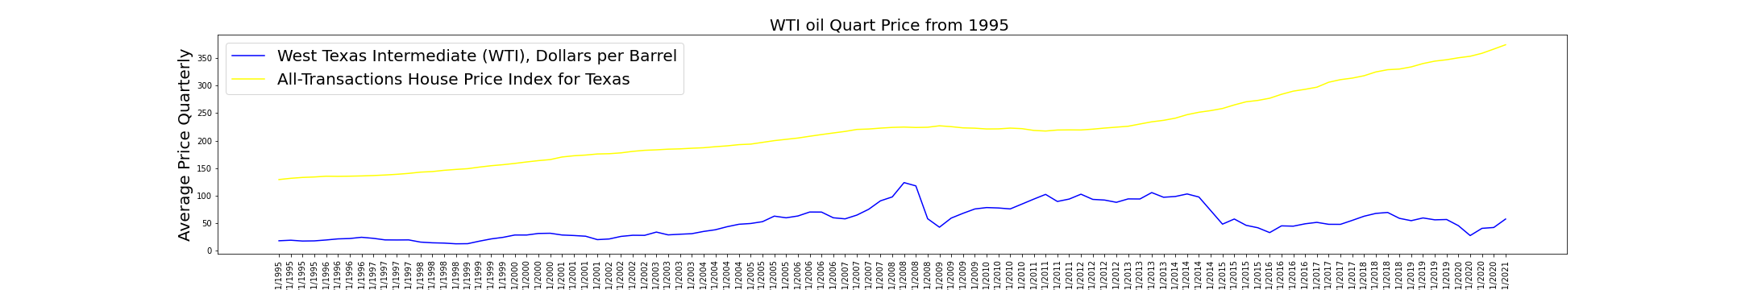
Price Oil Index vs House Price Index
There is no evident relationship between oil prices and the house price index.

Slide 14
Postmortem
Discuss any difficulties that arose, and how you dealt with them.
- Housing inventory was only available from 2018 till now.
Most recent census data is from 2020.
We were not able to determine the cause of the increase of lumber prices therefore we will not be able to determine if they would normalize.
Discuss any additional questions that came up, but which you didn't have time to answer: What would you research next, if you had two more weeks?
We did not find any data analyzing the housing bubble from 2008 compared to the current trend in housing market.
Is the current trend a housing bubble (overinflation of real state prices)?
Analyze supply and demand based on counties, and other states.

Slide 15

Questions?

